Slide 1
TheUncarriables v2.0

Slide 2
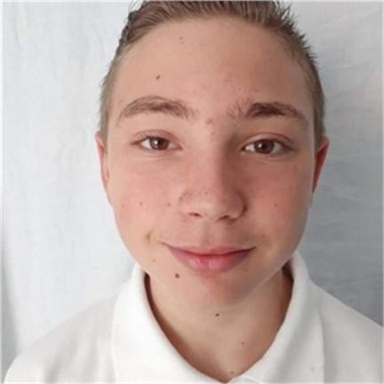
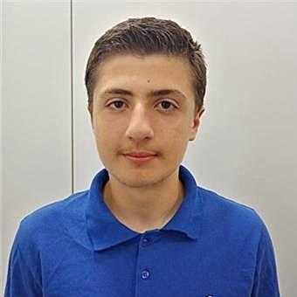
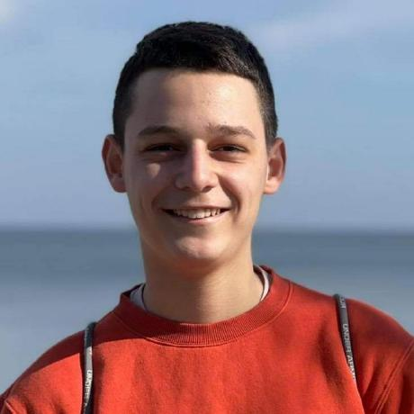
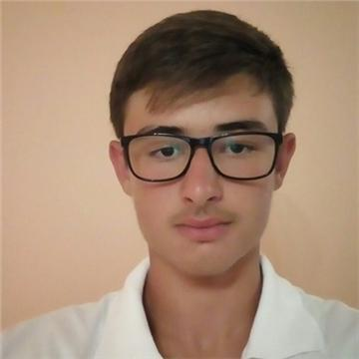
Our team
Denislav Bratoevski
Hakan Chandar
Alexander Baev
Ivaylo Stoyanov
Scrum trainer
Front-End developer
Designer
Back-end developer

Slide 3
Table of contents
01
02
Our project
Realisation
03
04
Used technologies
Demonstration
What it is?
How we did it?
Apps and websites used.
How it works?

Slide 4
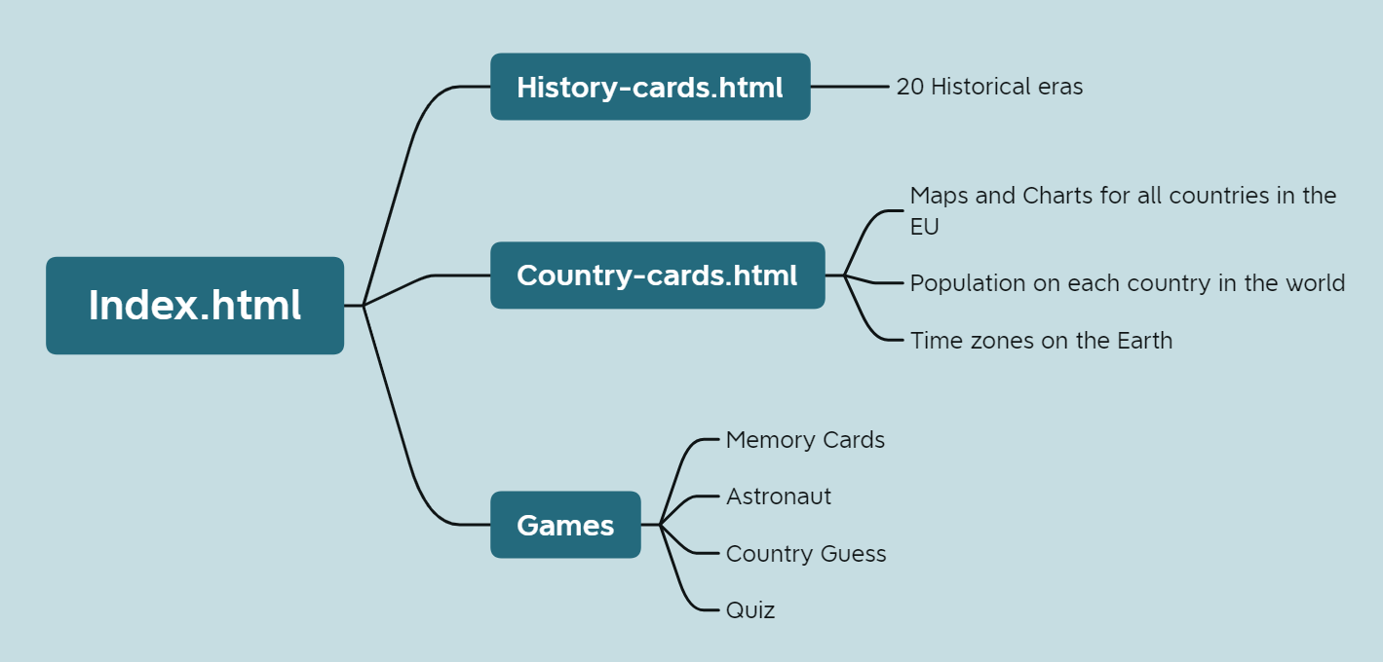
Our project
Our project is a website. The websites contains information about geography and history.

Slide 5
Realisation
Role selection
Work selection by role

Slide 6












Used Technologies

Slide 7

Demonstration

Slide 8
Now, let’s go to the website.

